Slide 1
CISC 5352 Final Project
Debarshi Dutta

Slide 2
Credit Risk worthiness evaluation
Two credit risk datasets: credit_risk_small_data_0.02.csv and credit_sim_data.csv both are imbalanced data. Why the former one fails almost all machine learning methods, but the latter has a very good results?

Slide 3
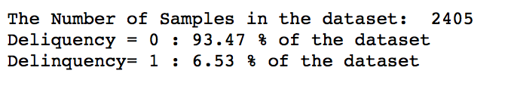
Dataset 1 is heavily imbalanced towards 0. Machine learning models are subject to a frequency bias in which they place more emphasis on learning from data observations which occur more commonly. Datasets that are inherently more difficult to learn from an amplification in the learning challenge when a class imbalance is introduced. Standard classification metrics do not adequately represent model’s performance. Because
Because of this, any model trained On an Imbalanced data set such as this will produce inaccurate Results. Since this data set is biased towards delinquency zero, there will also be a bias in any model is built on this data. When tested, the model will reflect the bias and provide a poor score for fitting.

Slide 4
Dataset 2 is heavily imbalanced towards 1. Because of this, any model trained on this Imbalanced data set such as this will reduce inaccurate Results. Since this data set is biased towards delinquency 1, there will also be a bias in any model is built on this data. When tested, the model will reflect the bias and provide a very high score for fitting.
Note- If the trained model is tested off a m-n split of the imbalanced data, the fit is not going to be either a very poor or a very good fit. The y_test on splitting the imbalanced dataset will also be imbalanced. So the predictions and the consequent regression score will not be very poor or very good.
When this trained model is tested against a balanced data set, the results are going to be wildly good or wildly bad.

Slide 5
Can you find a method to detect their built-in difference even before running a learning machine?
Dividing the number of individual labels with the length of the class will give the percentage of the labels,

Slide 6
Compare the performance of deep learning models for two datasets
– run an LSTM model for the two datasets and explain their performance (extra credits)

Slide 7
LSTM
Steps
Import the dataset(s)
Normalize the dataset (in this case i used the MinMaxScaler)
Deal with the data imbalance (I used SMOTE)
Separate the label from the data
Split the data (i split it in the 80-20 ratio)
Convert the test data into the 3-D Format accepted by the LSTM

Slide 8
LSTM (contd.)
Steps
Create the LSTM model
Compile the model
Train
Repeat the data conversion for the 3D LSTM format for the testing data
Predict the label

Slide 9
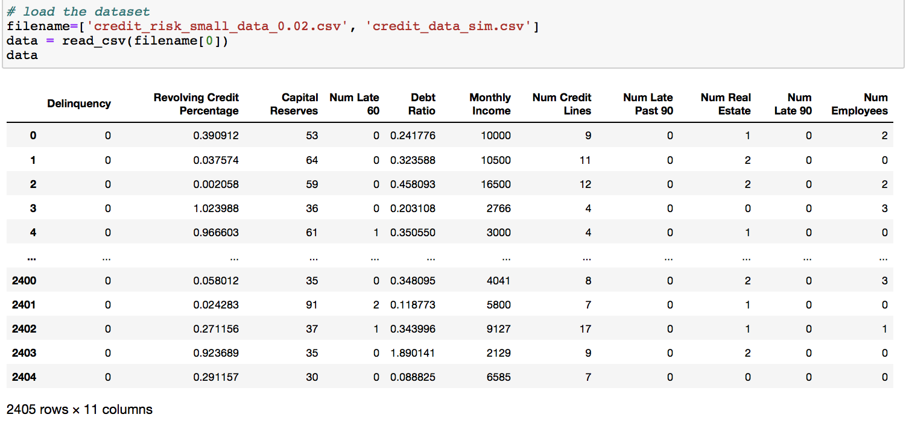
Data -1

Slide 10
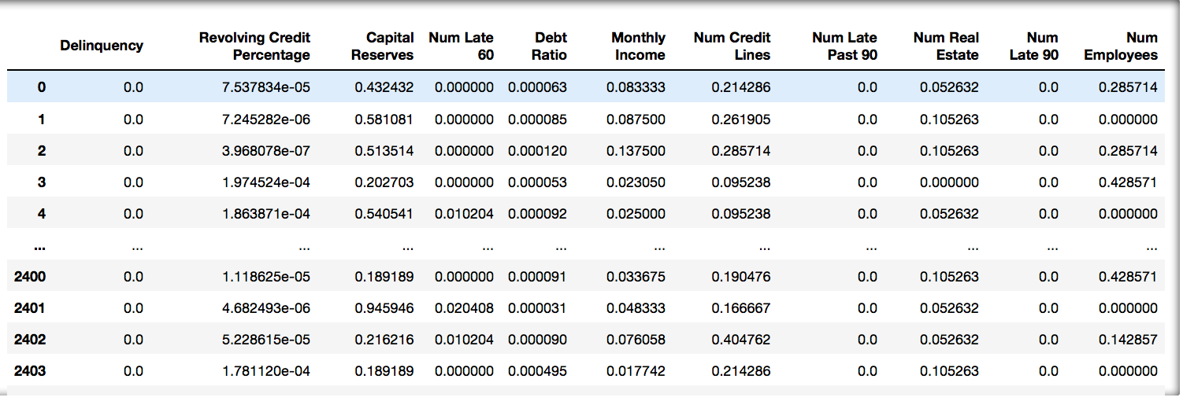
Normalized Data - 1

Slide 11
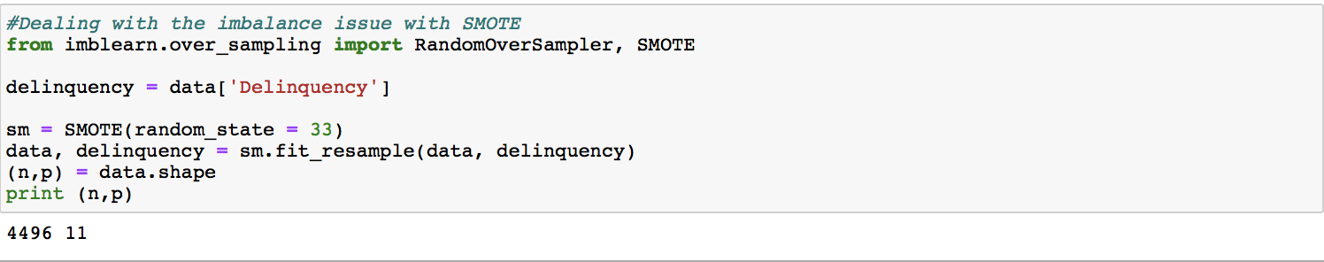

Slide 12
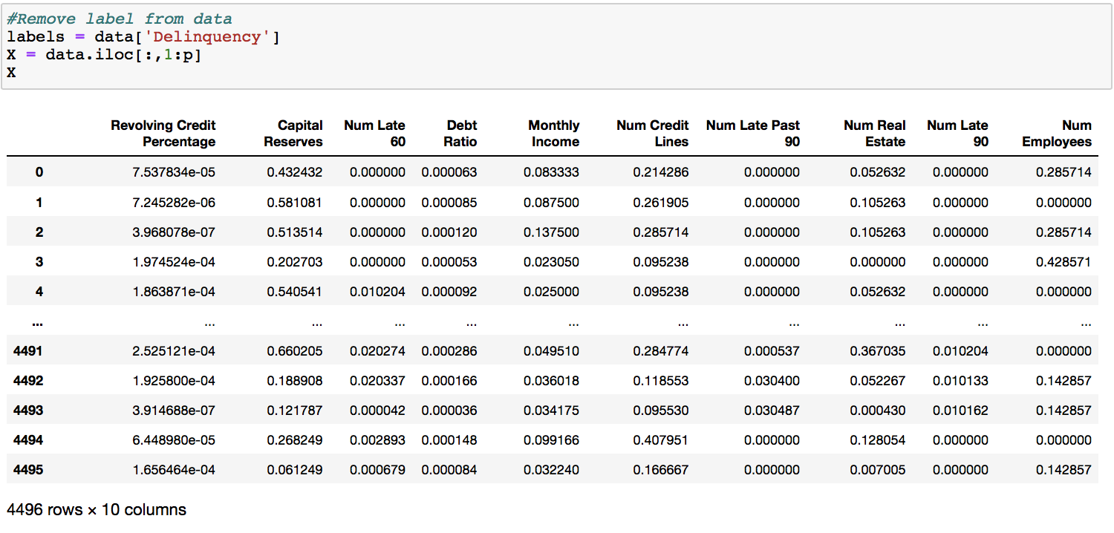

Slide 13
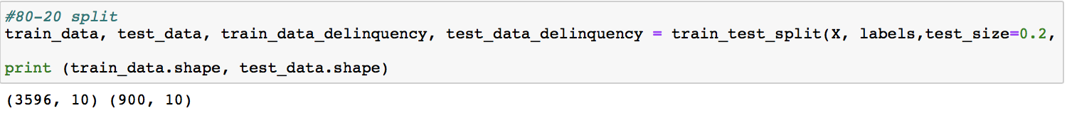
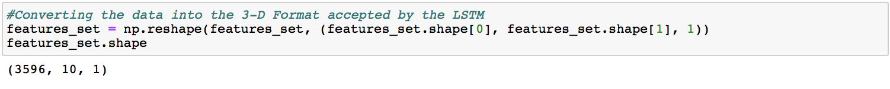
Convert the train_data into the 3-D LSTM format

Slide 14
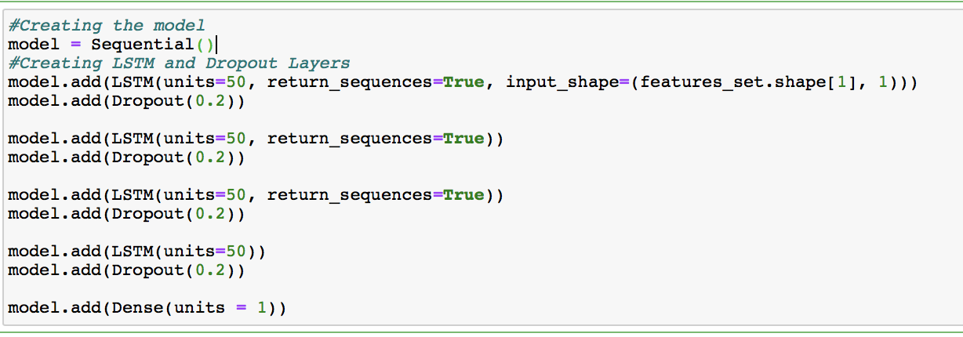
Creating the model
Model Compilation

Slide 15
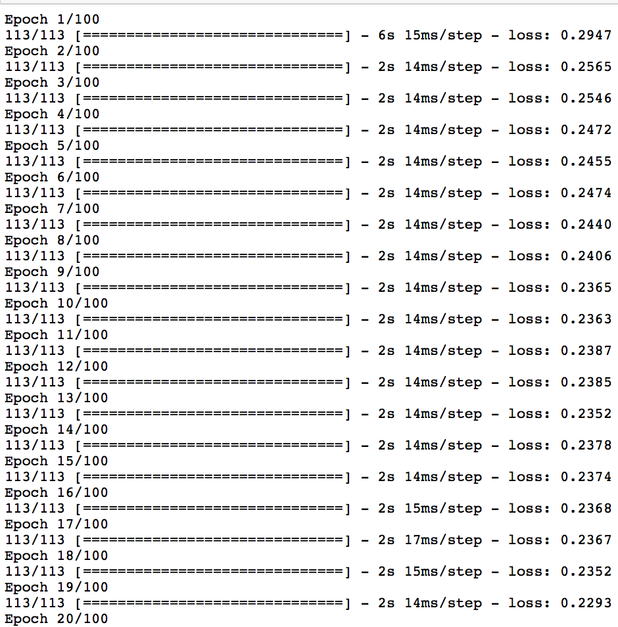
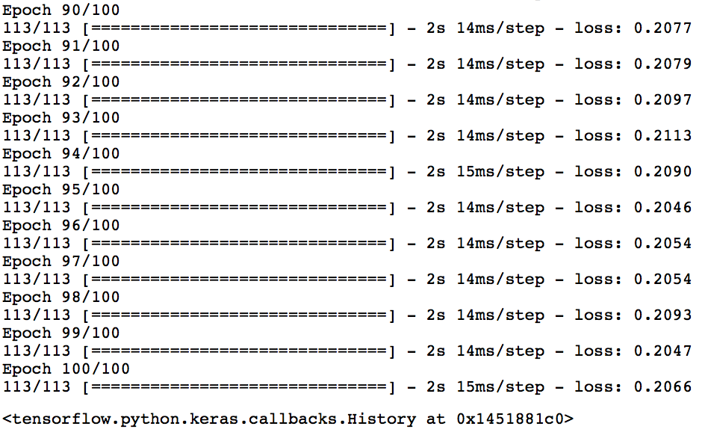

Slide 16
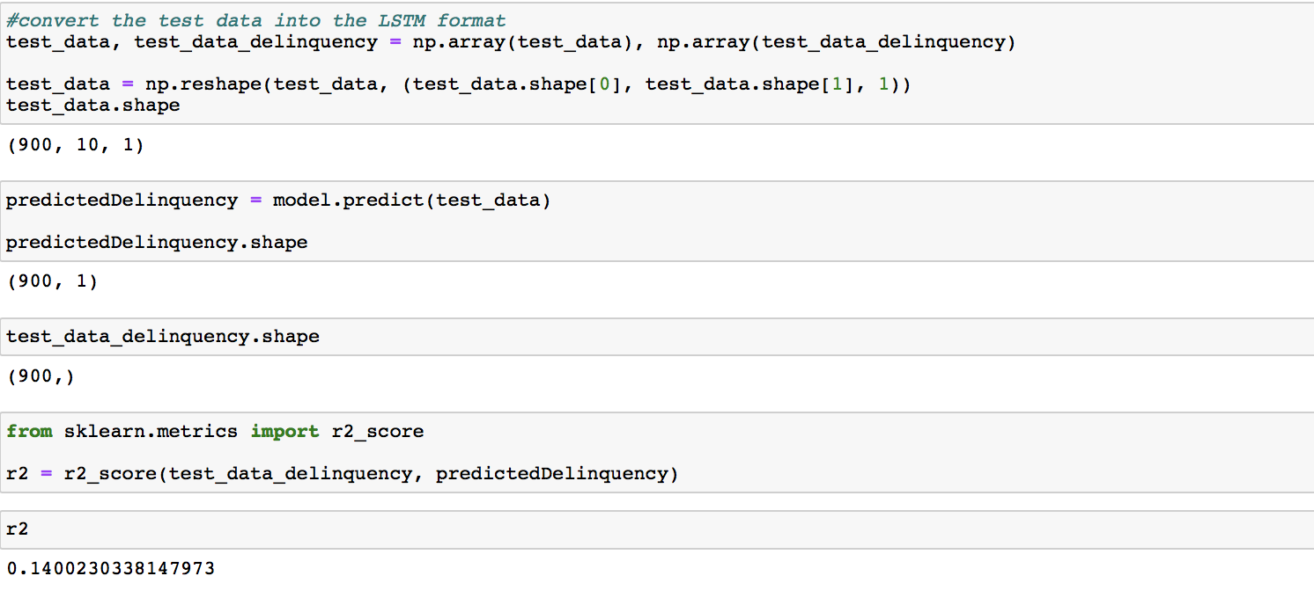

Slide 17
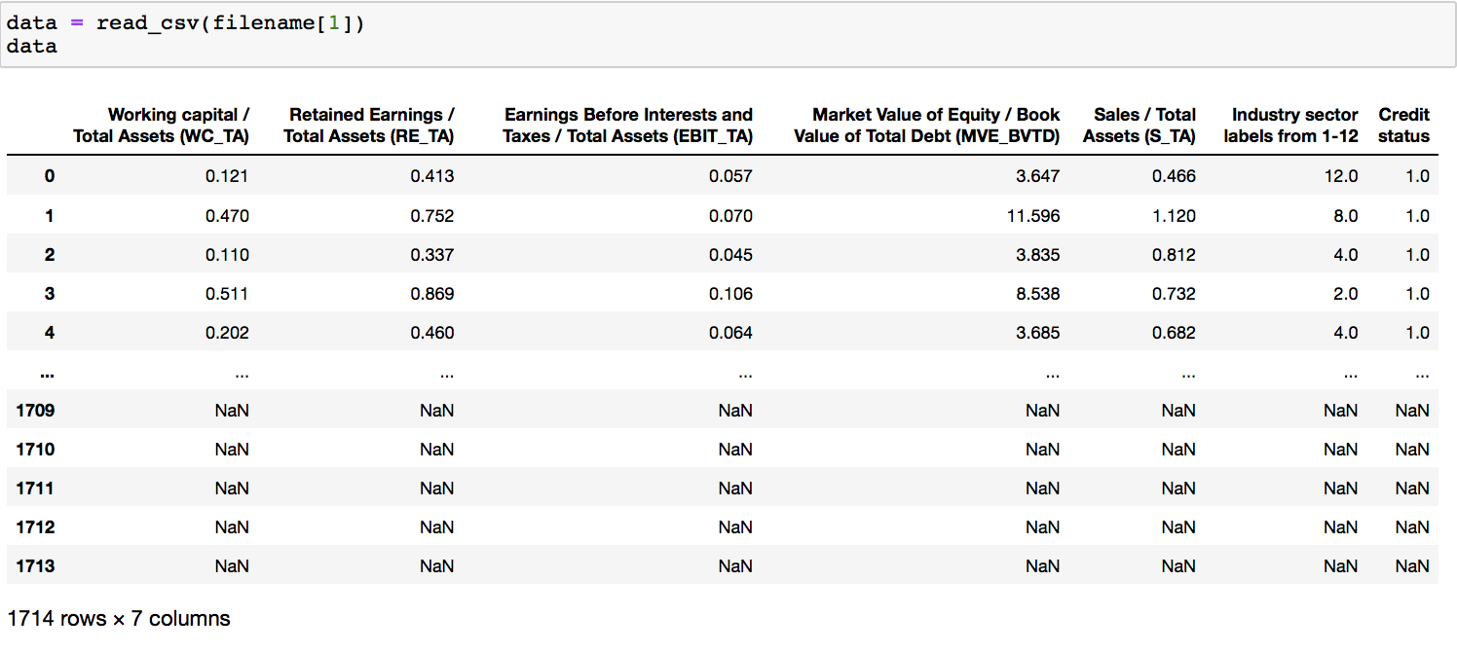
Data - 2

Slide 18
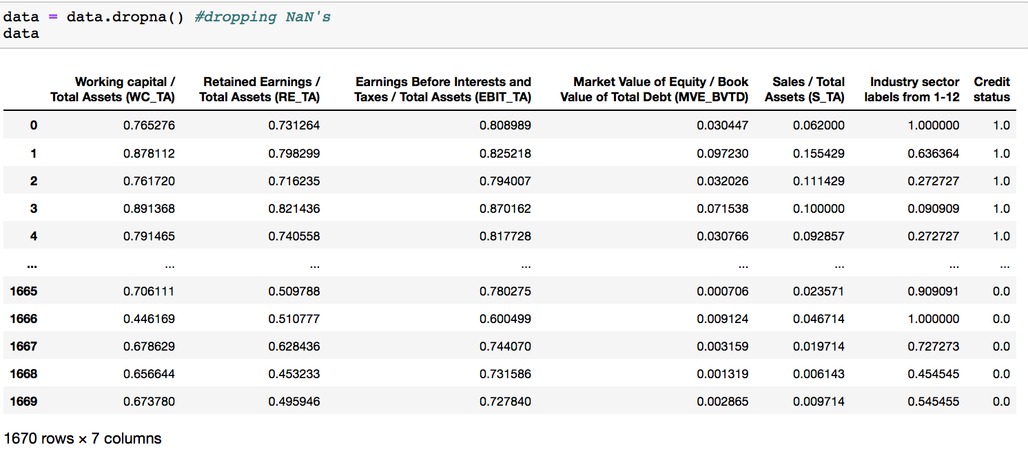
Normalized And Cleaned Data - 2

Slide 19
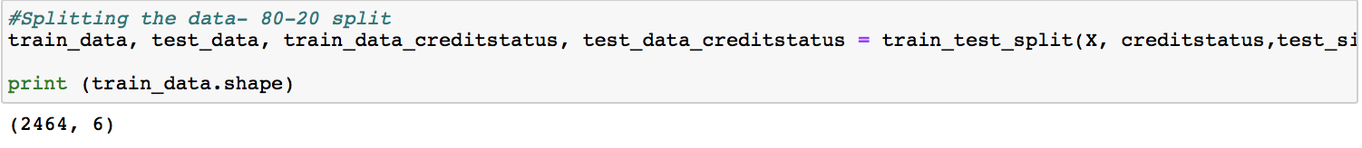

Slide 20
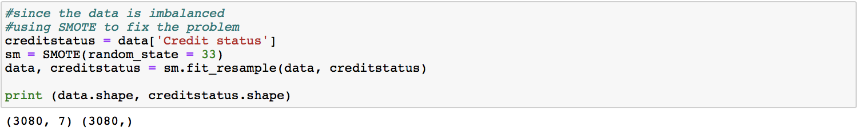
Training Data

Slide 21
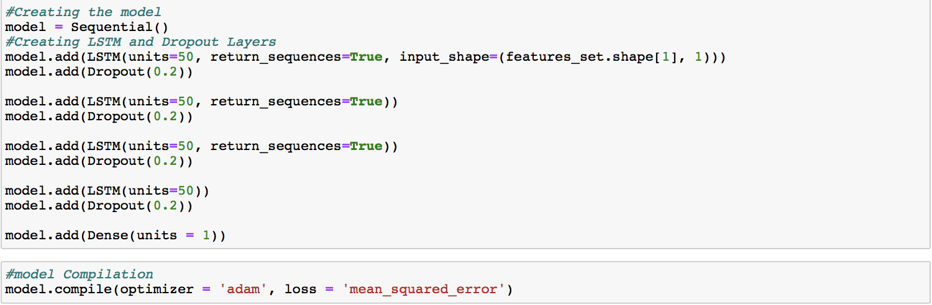

Slide 22
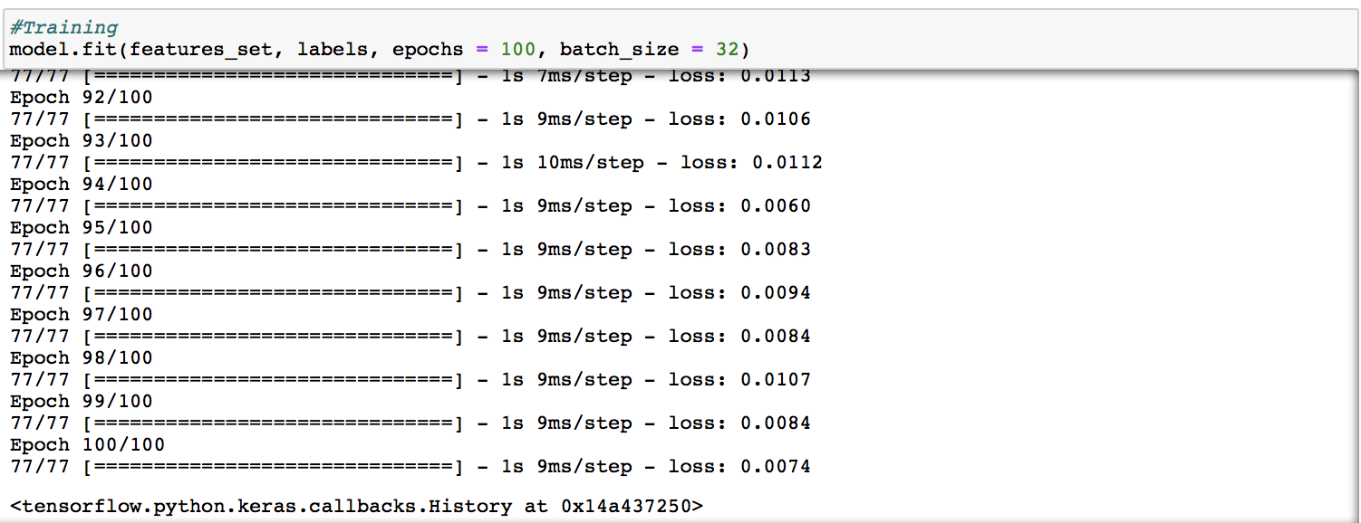

Slide 23
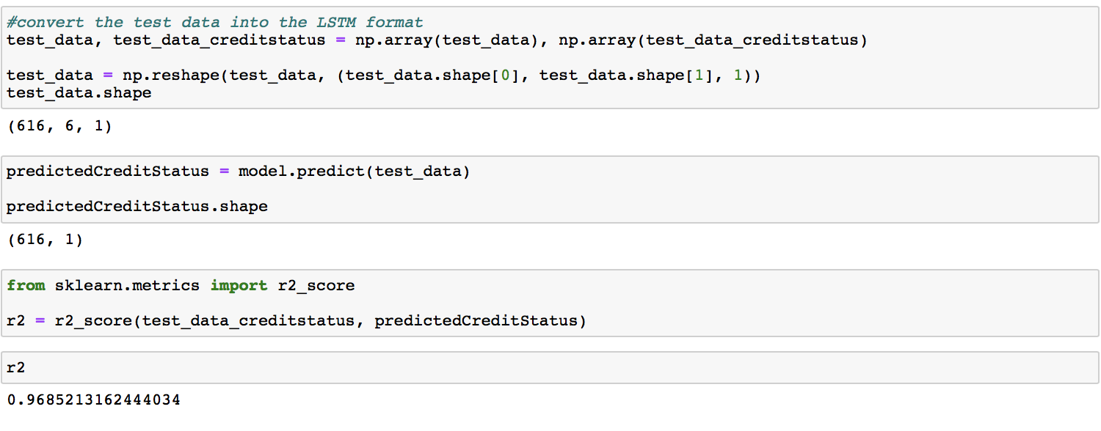

Slide 24
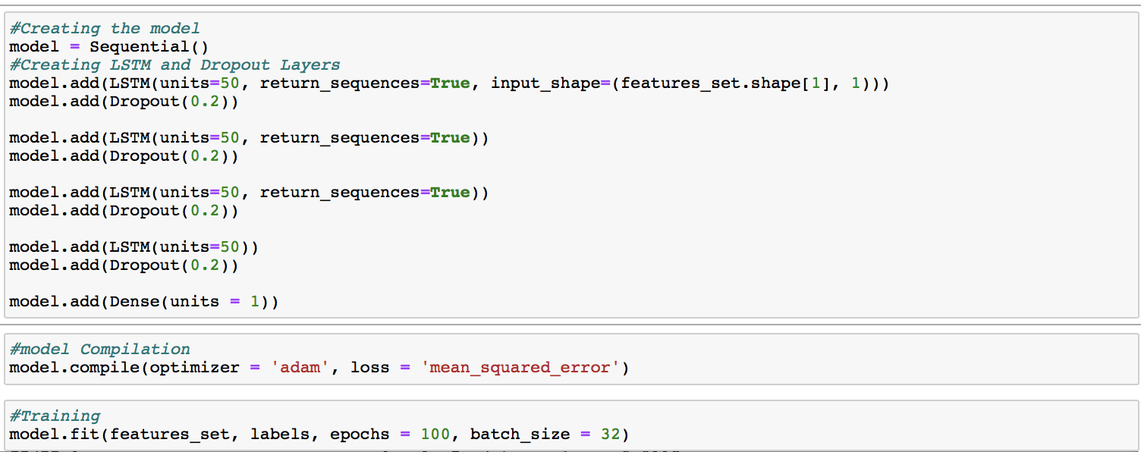
Analysis - model performance

Slide 25
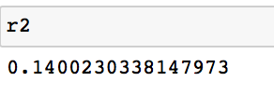
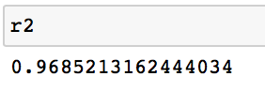
Analysis- model performance
Dataset 1 performed poorly
Dataset 2 performed very well.

Slide 26
Credit data in credit_risk_small_data_0.02.csv has good separations un- der t-SNE /UMAP (you may need to use minmax normalization)
– Partition data as 80% training and 20% test.
– Do t-SNE/UMAP for the training data.
– Project the test data to the t-SNE/UMAP subspaces so that can you do credit risk prediction in the subspace

Slide 27
Design a multilayer perceptron (MLP) with at least 2 hidden layers (DNN) to predict your test data ,and calculate at least six classifica- tion metrics including diagnostic index
1. Compare three training methods of MLP: adam, SGD and lbfgs.

Slide 28
Steps
Import the data
Normalize the data - used MinMaxScaler
Deal with the data imbalance- used SMOTE
Separate label from the data
Split the data
Compile the model
Fit the model
Predict the label
Check the performance

Slide 29
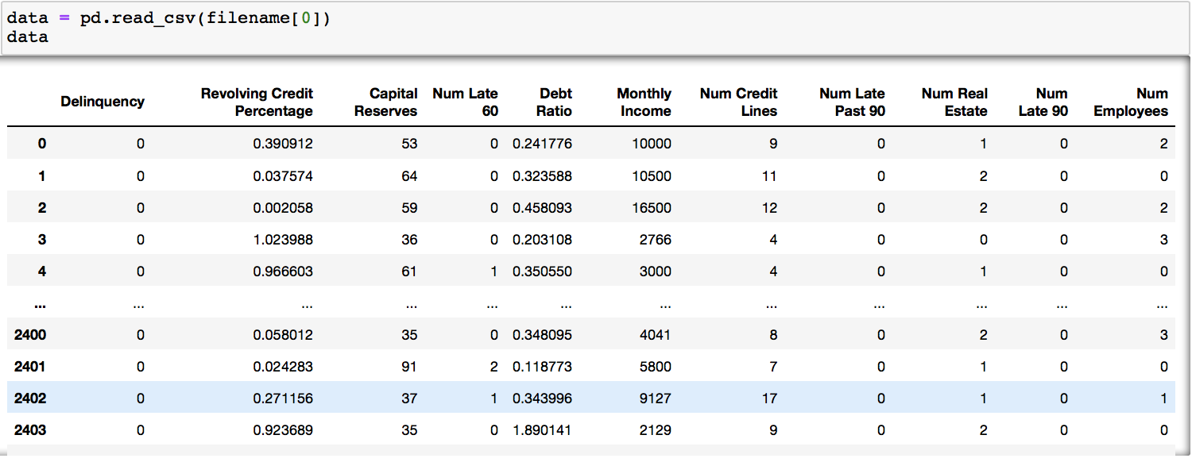
Dataset 1

Slide 30
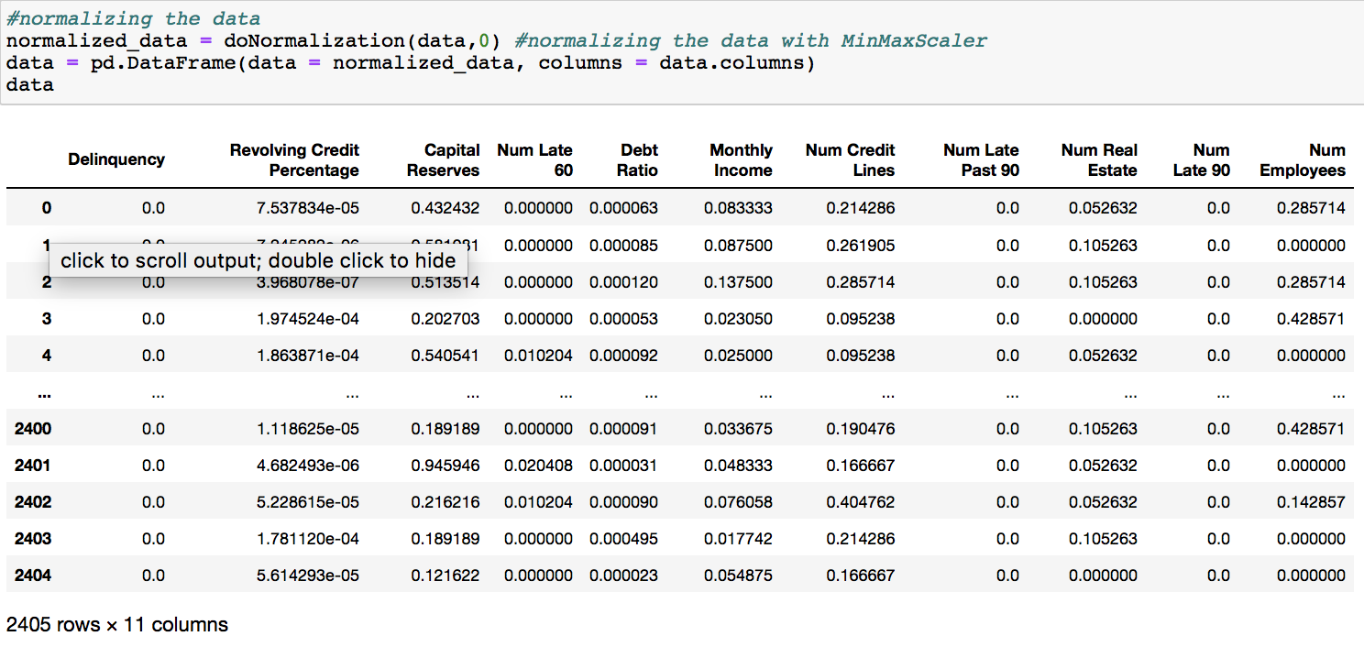

Slide 31
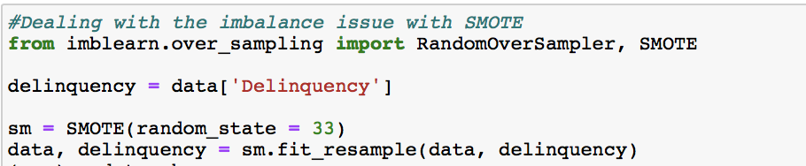

Slide 32
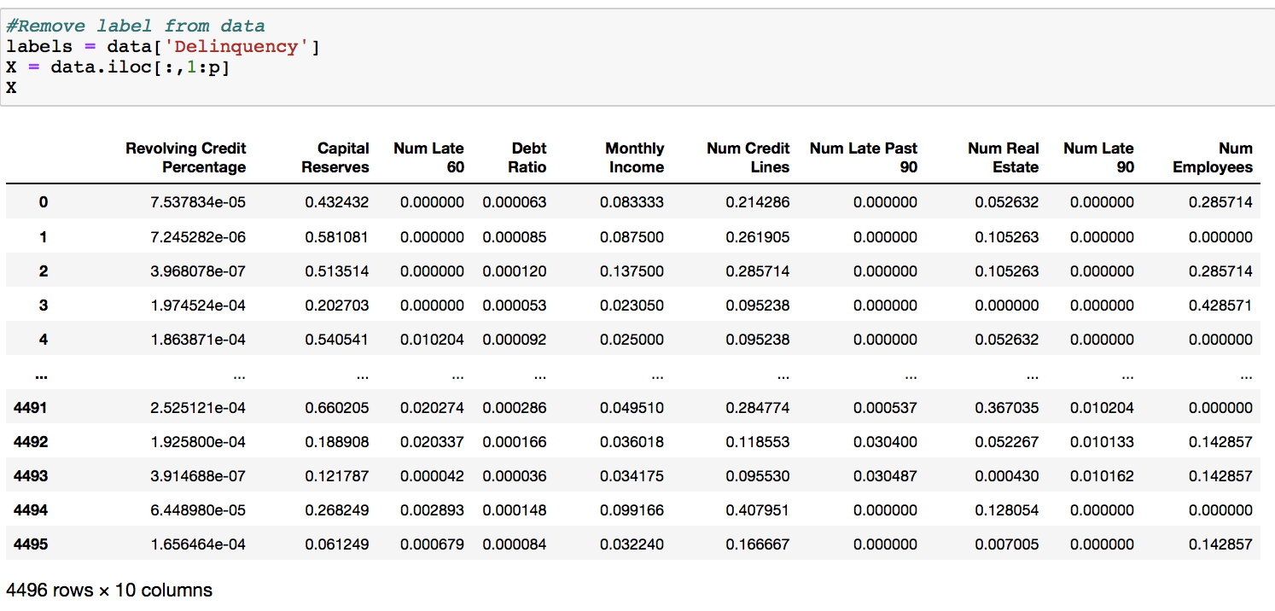

Slide 33
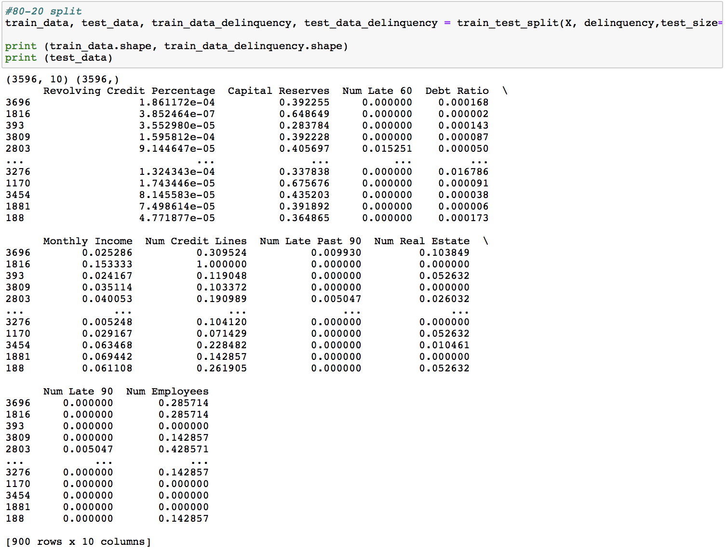

Slide 34
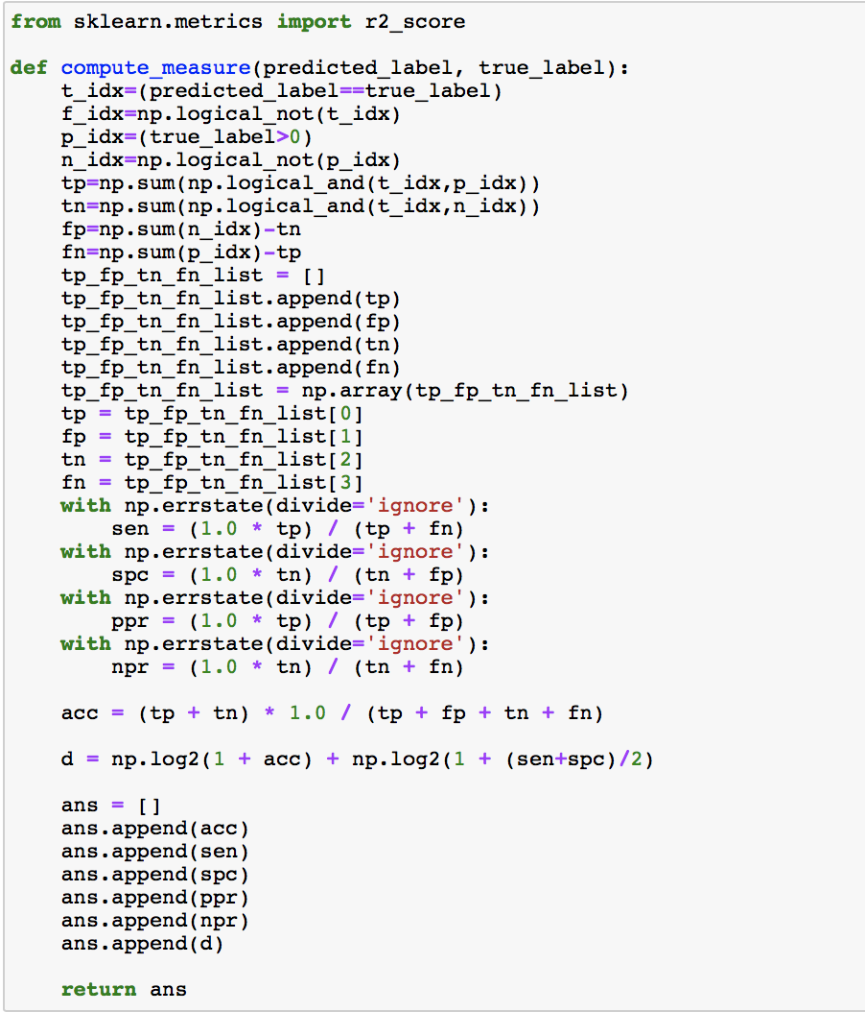

Slide 35
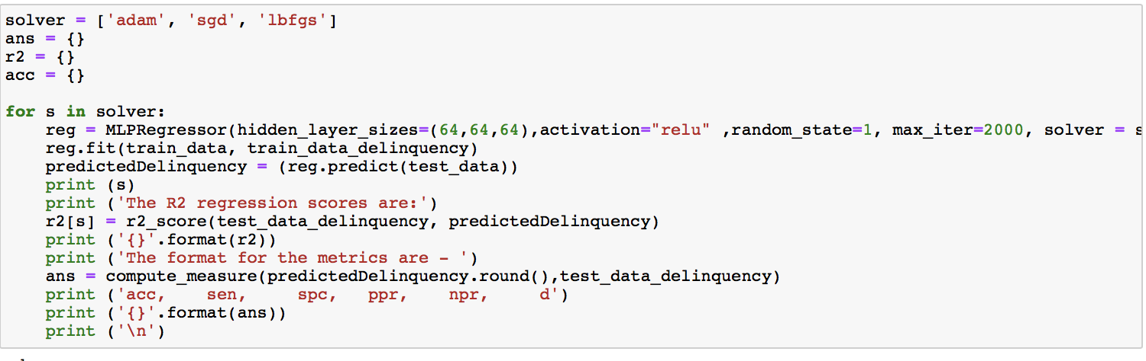

Slide 36
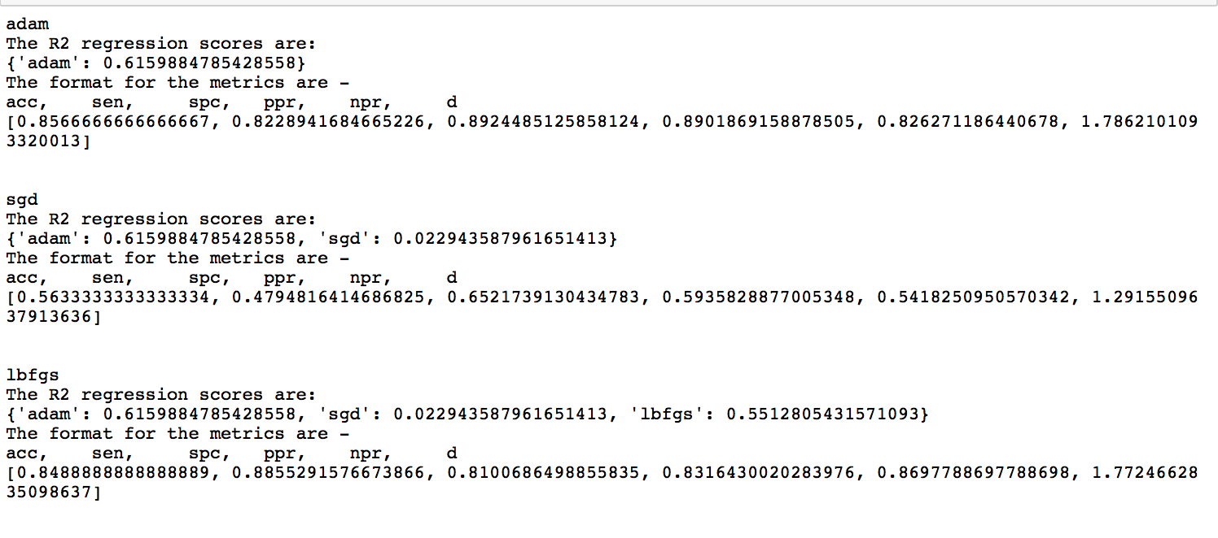
Comparison-

Slide 37
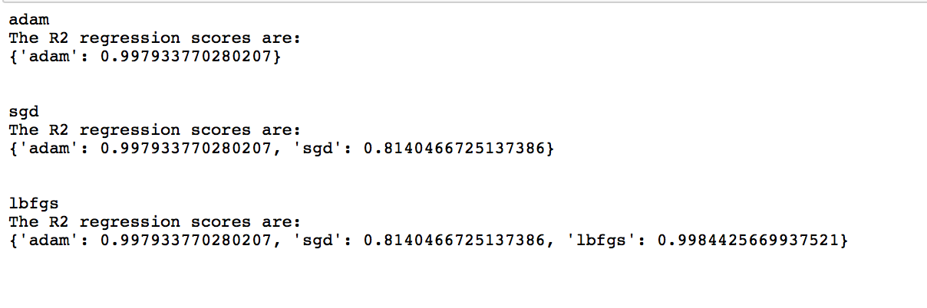
Dataset 2
Comparison

Slide 38
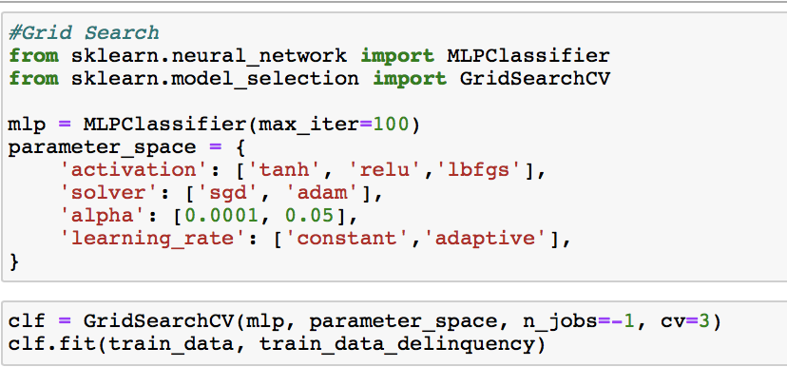
2. Turn DNN by gridSearch using d-index and check its performance
Model

Slide 39
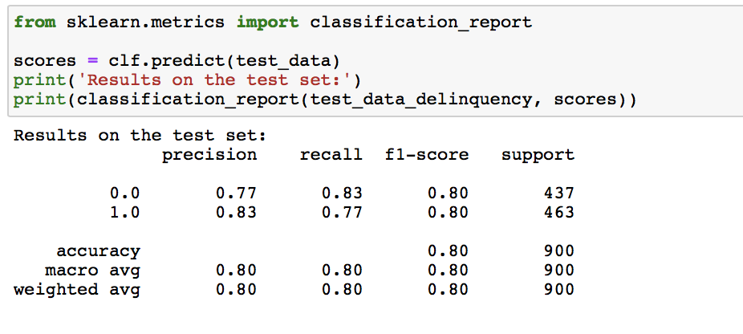
Dataset 1

Slide 40
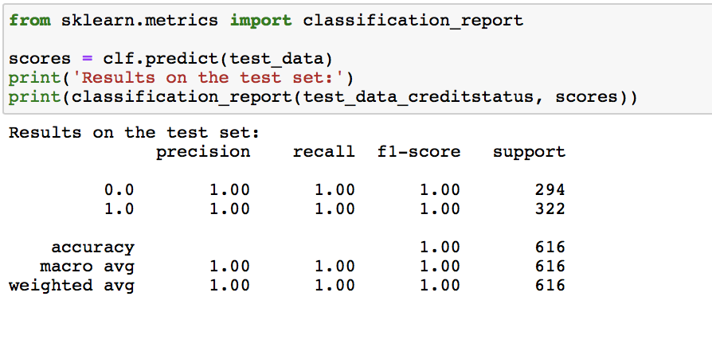
Dataset 2

Slide 41
Credit data in credit_risk_small_data_0.02.csv has good separations un- der t-SNE /UMAP (you may need to use minmax normalization) – Partition data as 80% training and 20% test. – Do t-SNE/UMAP for the training data. – Project the test data to the t-SNE/UMAP subspaces so that can you do credit risk prediction in the subspace

Slide 42
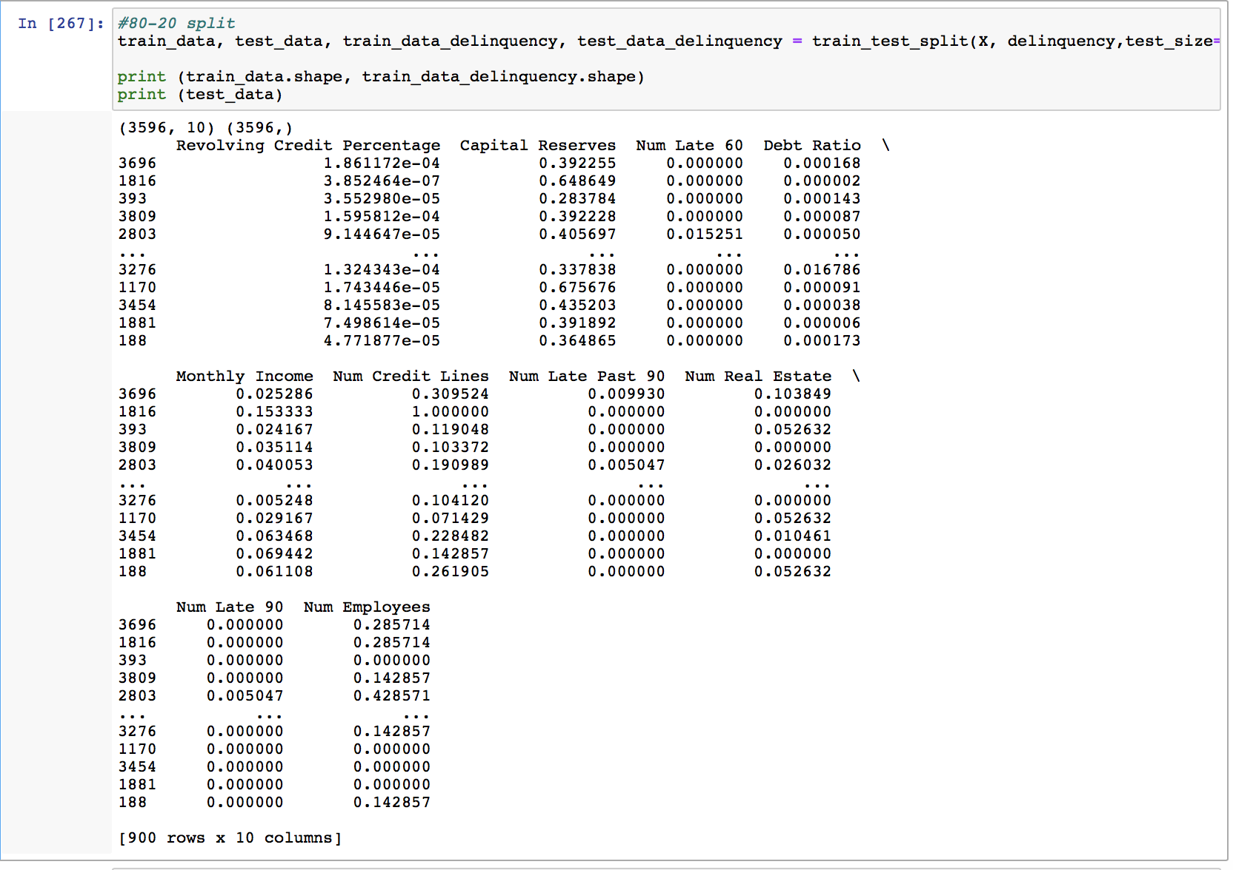
Data Split

Slide 43
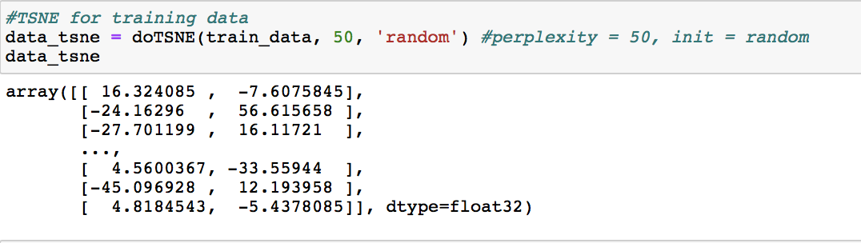
t-SNE

Slide 44
The reduce in dimensionality of the labels can be done by the unsupervised k-Means and finding the accurate number of clusters by using kneeLocator

Slide 45
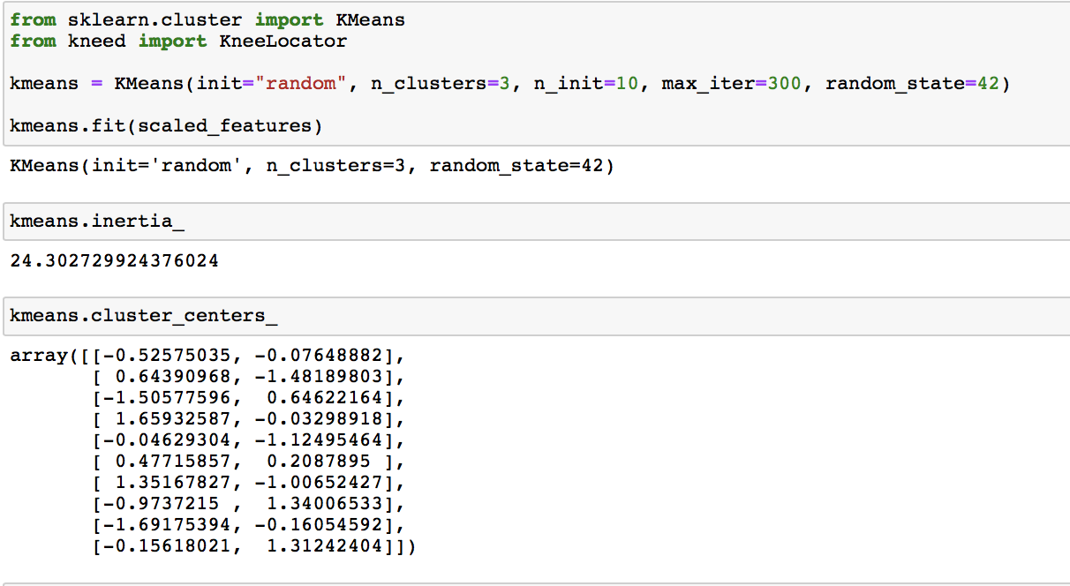
k-Means

Slide 46
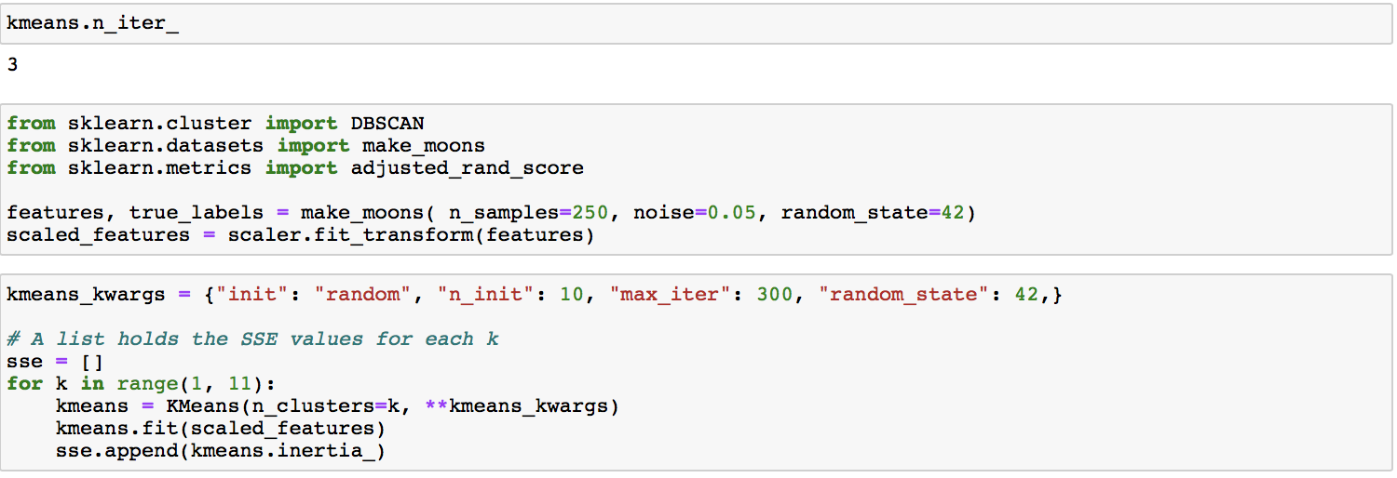

Slide 47
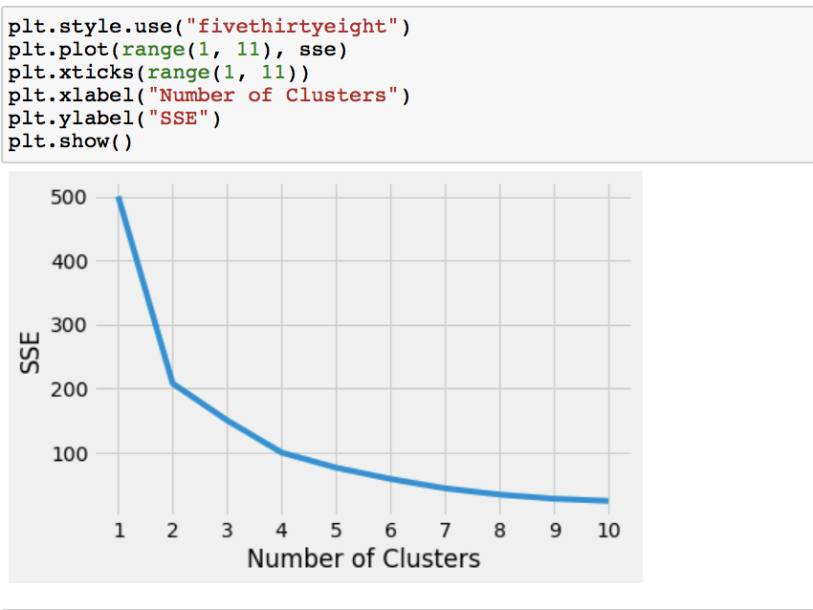
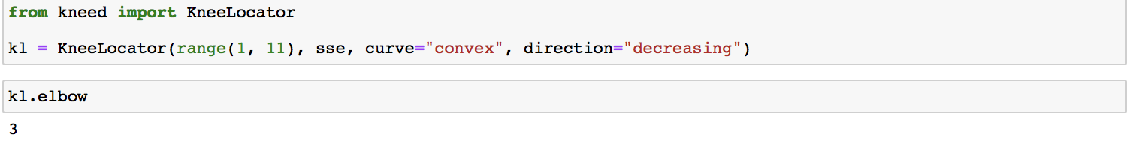

Slide 48
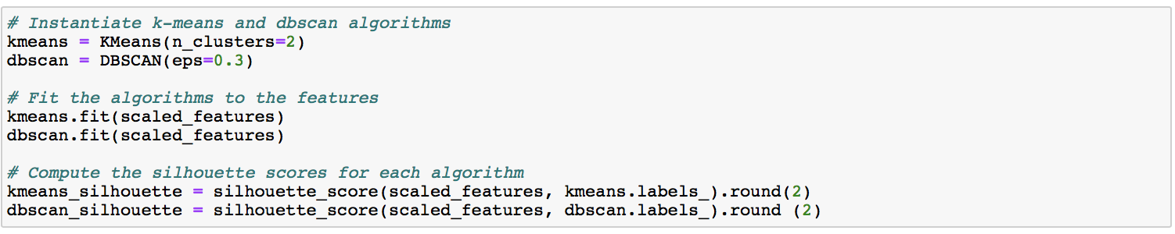
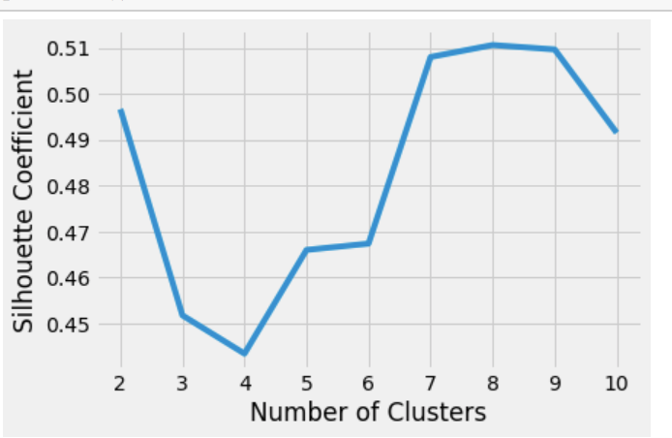
t-SNE and DBSCAN

Slide 49
Hierarchical learning in P2P leading
Clean their dataset: Loan.csv so that it will be ready for credit risk prediction (You may need to remove some features)
• Apply hierarchical learning to the cleaned dataset and compare its per formance with that in paper

Slide 50
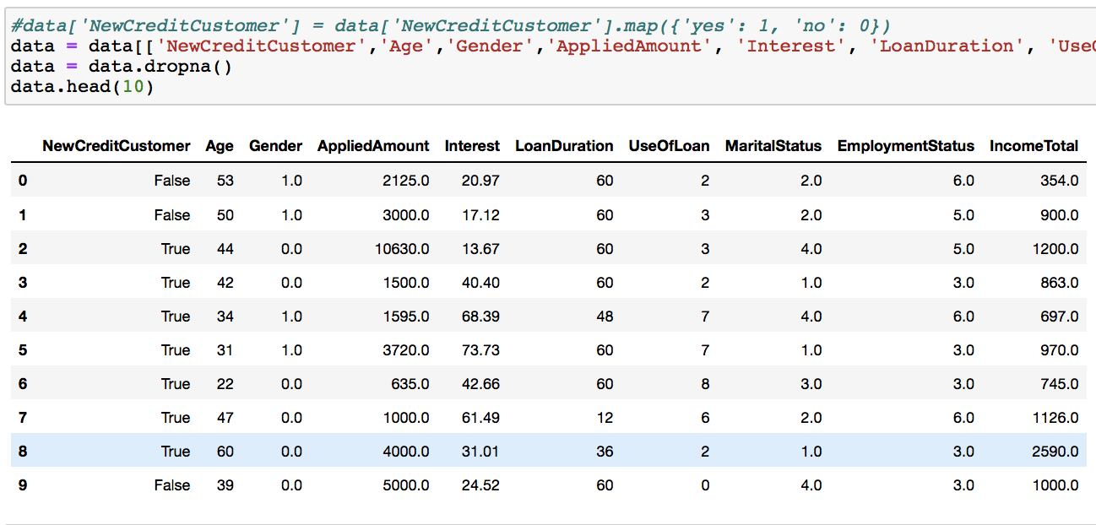
Clean their dataset
Cleaned according to the instructions provided.
Main intention was to make sure that my target and the one in the paper matched, so that the performance can be compared accurately

Slide 51
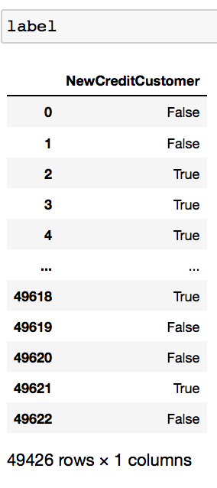
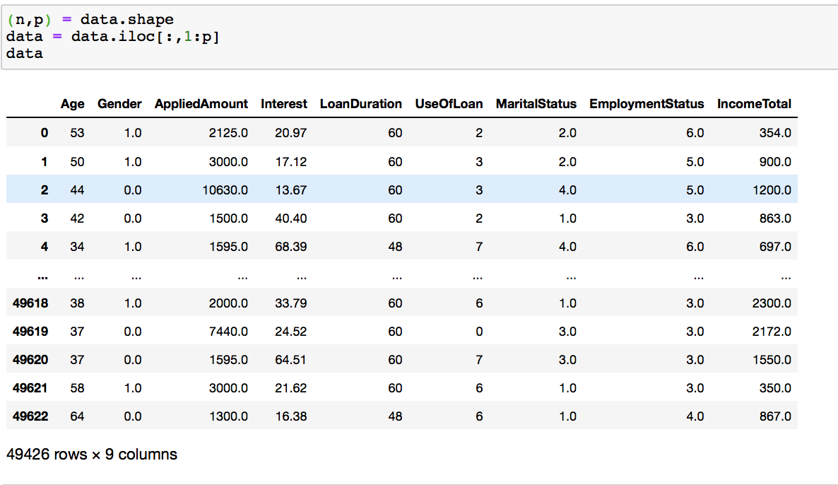
Separate the data and the label

Slide 52
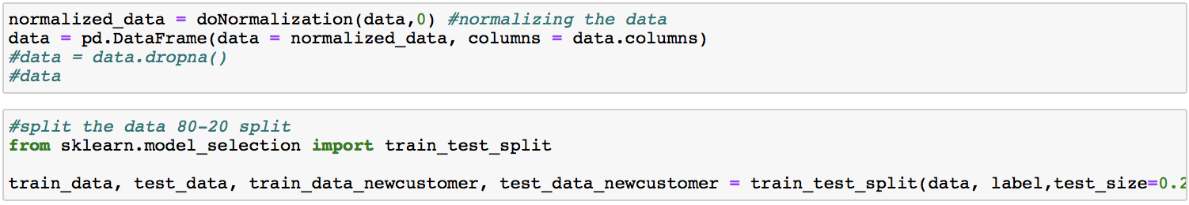
Normalize the data, 80/20 split

Slide 53
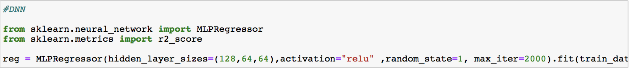
Setup the DNN and the train the model
Make the Prediction

Slide 54
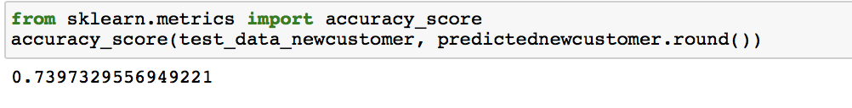
Accuracy
Analysis
The model shown in the paper has an accuracy of 75.8%
The model that i have built has an accuracy of 73.97% ~ 74%
So the model in the paper performed better

Slide 55
3) Endowment analytics (200 points)
Dimension reduction analysis
• Do PCA, SPCA, t-SNE, LLE analysis for two datasets to generate biplots as follows and interpret its meaning and outliers (Note: you don’t need to use the label info when doing such analysis; The twitter names or inits are good for you to label data)

Slide 56
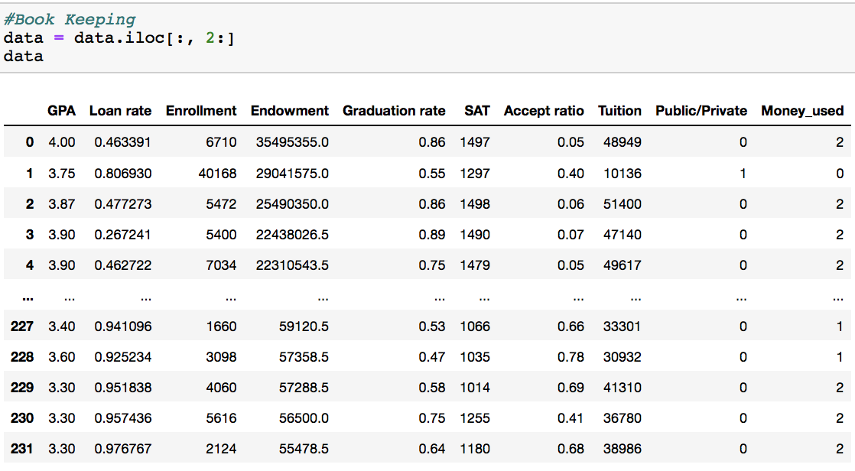
After book keeping and cleaning the data

Slide 57
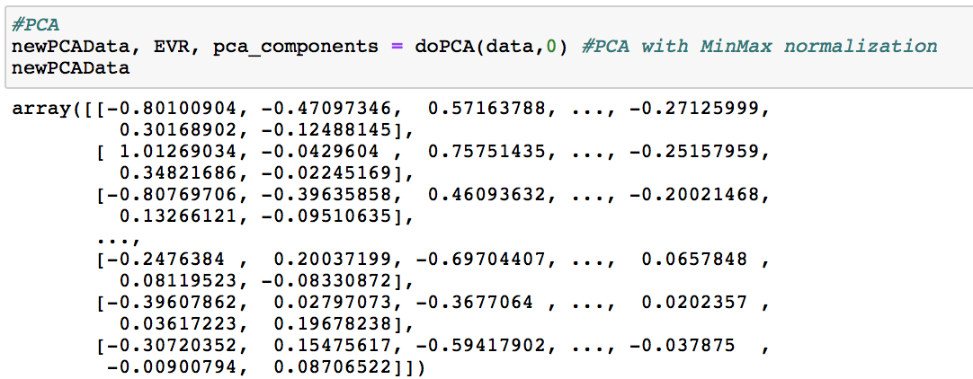
PCA subspace

Slide 58
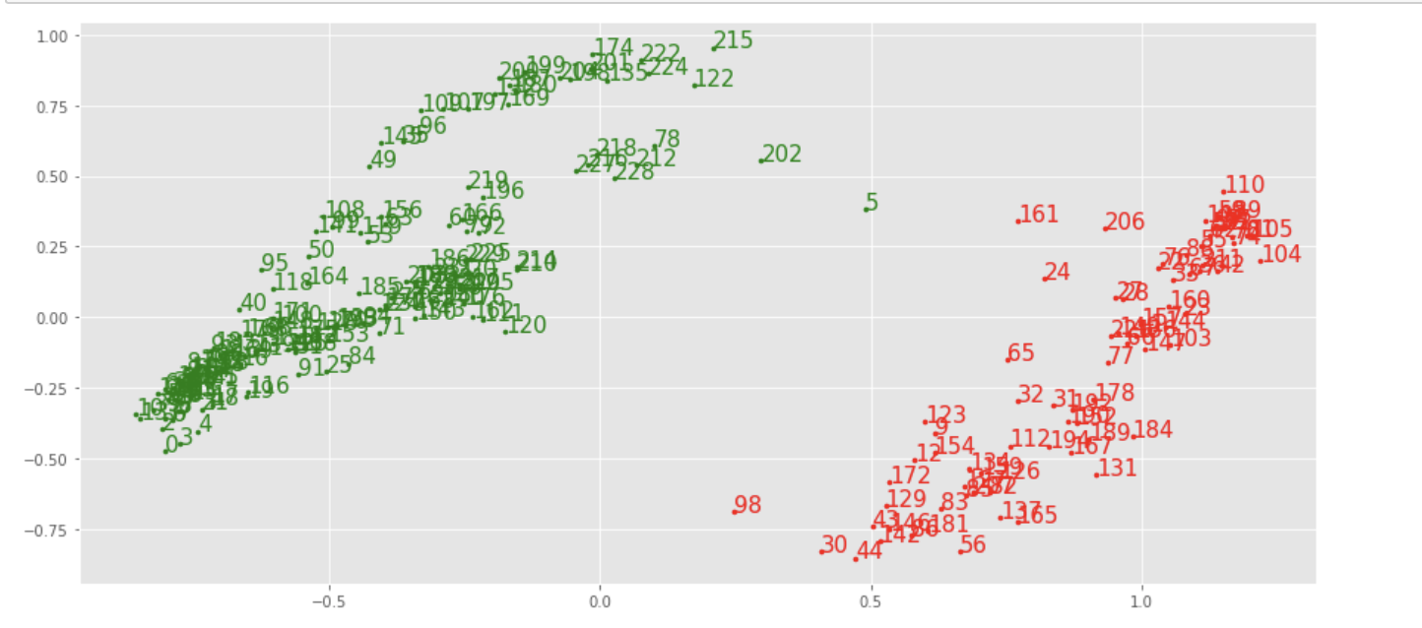
Biplot
Init used as label

Slide 59
Visualize the two datasets data similar to the following plot (label data via their money usage) via PCA, SPCA, t-SNE, LLE analysis for two datasets
– Diamond: poorly used; square: fairly used; dot: well-used –
Green: public school, red: private school

Slide 60

Init used as label

Slide 61
Write an algorithm to find the 5 nearest neighbors (peers) in the
PCA/SPCA/t- SNE/LLE space
for each institution by using at least two components)
– Show the 5 neighbors (peers) of Fordham University, Michigan state, Yale, Smith college)
– If there is no 5 neighbors available, your algorithm should give an reason.

Slide 62
Steps
Import the data
Normalize the data
Isolate the individual row for Fordham, Michigan State, yale and Smith College
Convert the data into the PCA subspace
Find the 5 nearest neighbors
Using Nearest neighbors from sklearn
algorithm='auto',
leaf_size=30,
n_neighbors=5,
p=2
radius=1.0,

Slide 63


Slide 64



Slide 65



Slide 66
Apply hierarchical learning to the endowment data in endowments_2018_with_init.csv by doing 70% and 30% train/test partition (you need to write your train-
ing and test daat as train.csv and test.csv)
• Calculate the classification measures and d-index (Note you need to write a routine to calculate the multi-class d-index)
• Apply hiearchical learning to the new test data: newData.csv and Calculate the classification measures and d-index
• Draw your conclusion

Slide 67


Slide 68


Slide 69


Slide 70
Use Multiple Level Classification
Since the model is relatively small, a better evaluation is done using repeated k fold cross validation
Number of classes -1
Number of labels = 3- poorly used, fairly used and well used

Slide 71


Slide 72


Slide 73

Setting the parameters and evaluate the model

Slide 74

Training data

Slide 75


Slide 76

Test data

Slide 77


Fit the model and make the prediction

Slide 78

Evaluation
Metrics

Slide 79
Apply hiearchical learning to the new test data: newData.csv and Calculate the classification measures and d-index

Slide 80


Slide 81


Slide 82


Slide 83

Number of classes -1
Number of labels - 2- private and public

Slide 84




Slide 85

Evaluation
Metrics

Slide 86
Analysis
The accuracy of the first model run after the 70-30 split is 23%
After splitting the training data of the above model 70-30 and applying hierarchical learning
this second model has an accuracy of 69%, which is 3 times the last case
So, the accuracy increased significantly

